Slide 1
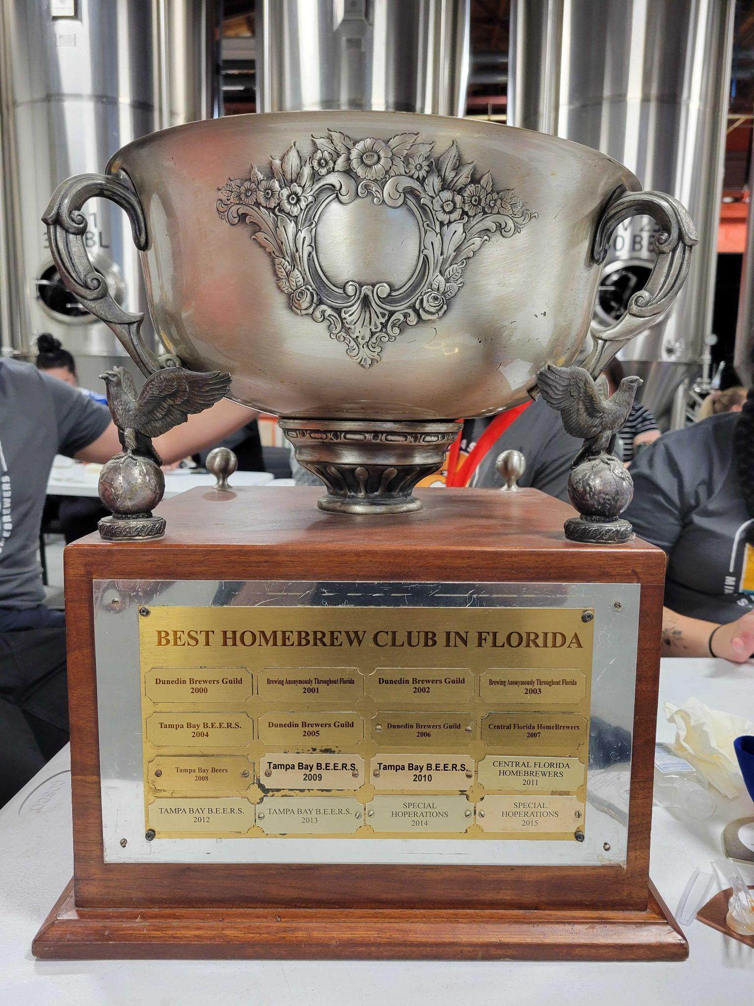
MASH MONTHLY MEETING OCTOBER 2022

Slide 2
PRESIDENT’S GREETING

Slide 3
TREASURER REPORT
TOTAL BALANCE: $4497
EXPENDITURES
TASTING GLASSES $125
NEW HORIZONTAL BANNER $60
T SHIRTS AND MEMBERSHIP CARDS-$1200

Slide 4
COMPETITION UPDATE
FLORIDA CIRCUIT
CASK 239 POINTS
MASH 219
BREWERS ANONYMOUS 201
UPCOMING COMPETITIONS
BEST FLORIDA BEER - OPENS 11/1 DELIVER BY 11/26
CURRENTLY NO ENTRY LIMIT LISTED
ALL COMPETITION INFORMATION IS LOCATED AT REGGIEBEER.COM

Slide 5
BREWER OF THE YEAR
STANDINGS
Brewer Name | Total Points
Fernando Espino | 90
Jim Walsh | 52
Macorix Perera | 52
Rafael Dubois | 40
David Kirsten | 36
Bob Billany | 34
Danny Smyth | 31
Gary Fuller | 26
David James | 25
Kayla Almeida | 25
Roosevelt de los Santos | 18
Steve Hiller | 18
Jamie Mann & Danny Eisenberg | 17
Chris Nash | 15
RUNNING AWAY WITH IT

Slide 6
NEW - OLD BUSINESS
PICK UP YOUR T-SHIRTS $25
NATIONAL LEARN TO HOMEBREW DAY 11/5 1PM @J.WAKEFIELD’S
HOSTED BY DANNY
NORTH MIAMI BREWFEST - 11/12@ 1PM
OFFICER NOMINATIONS ARE OPEN

Slide 7
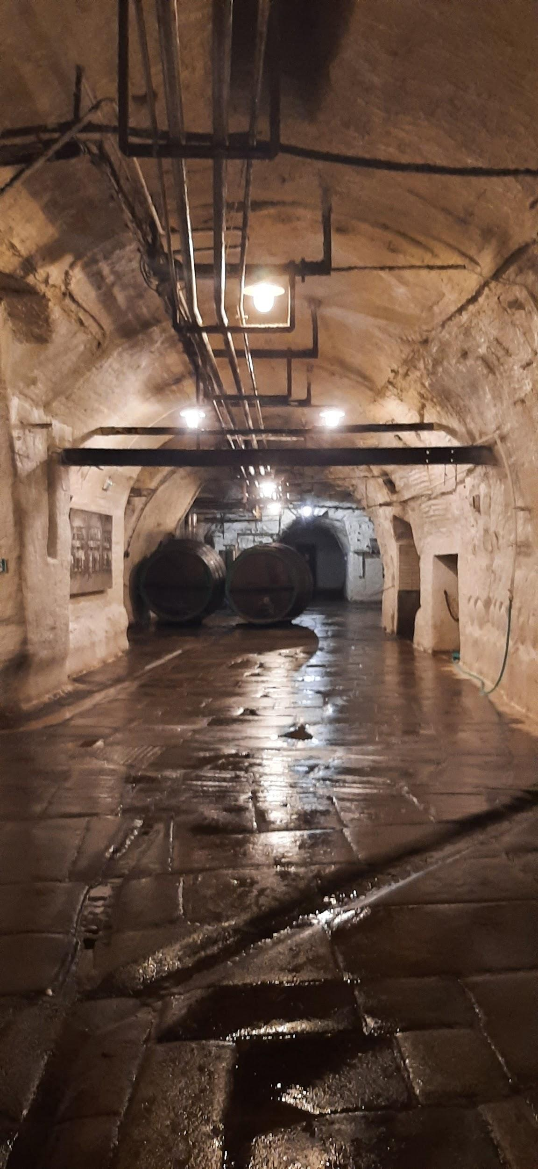
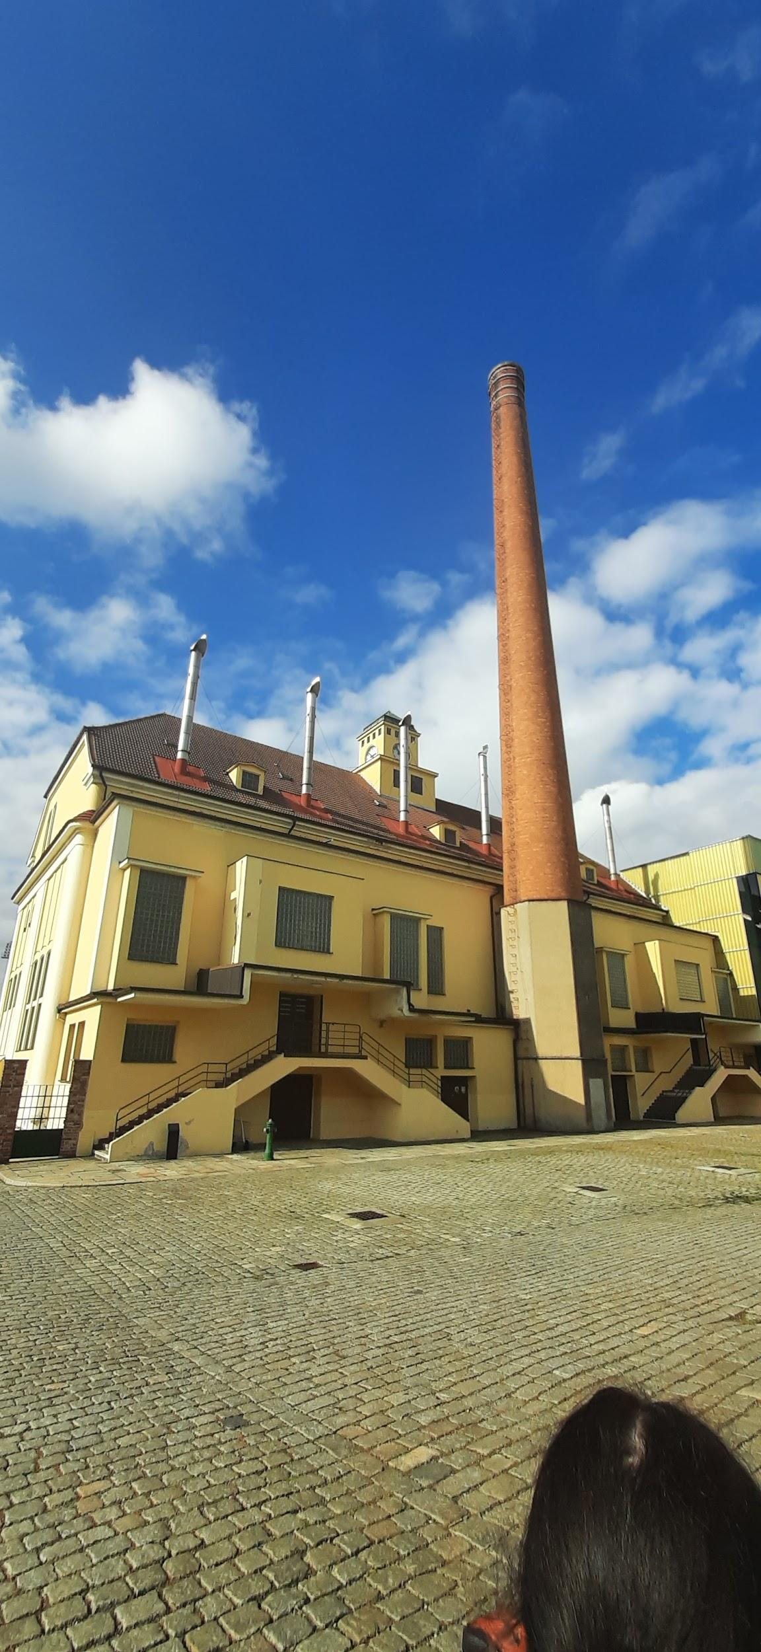
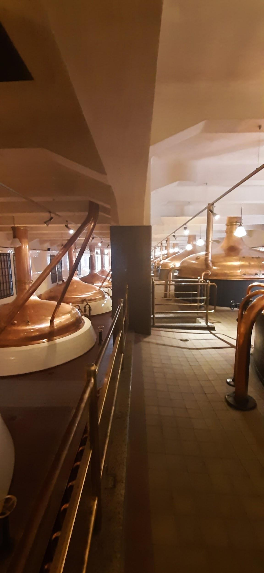
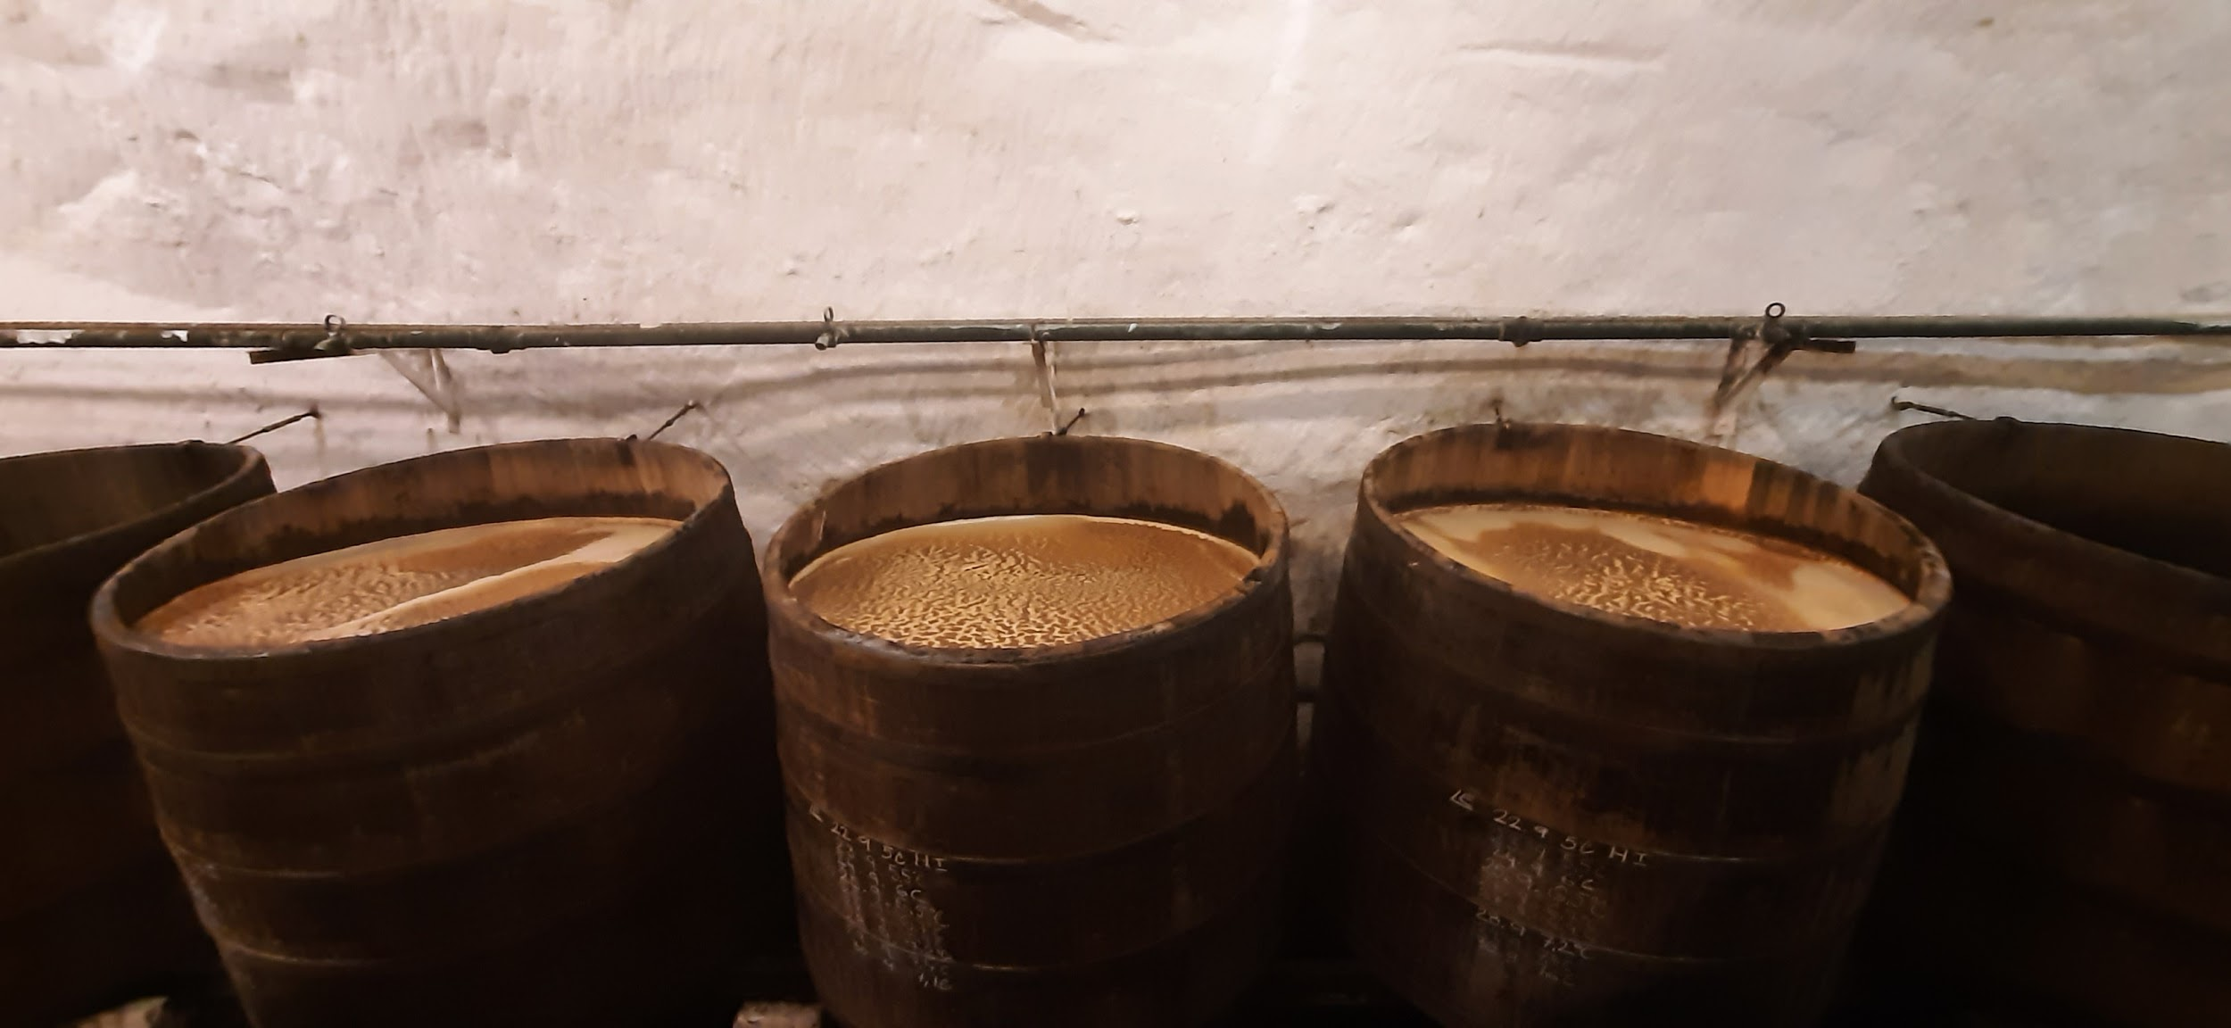
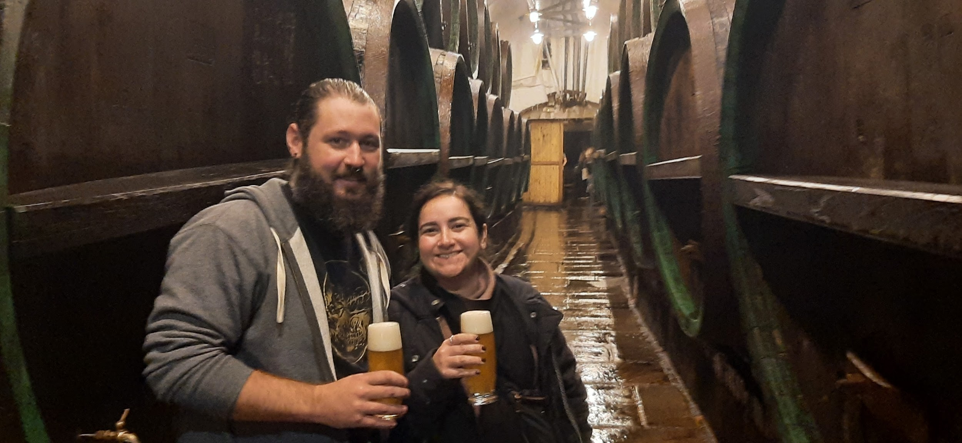
World Travelers

Slide 8
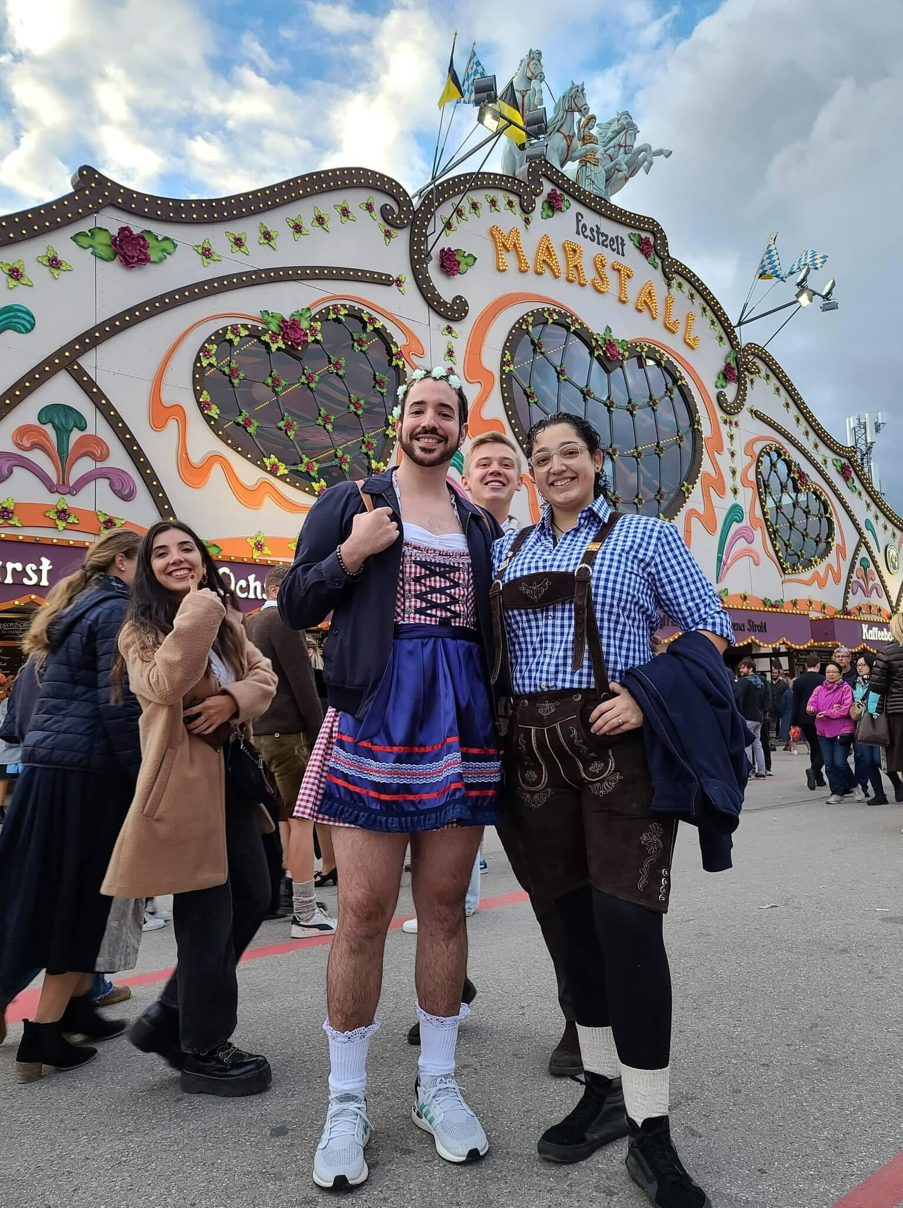
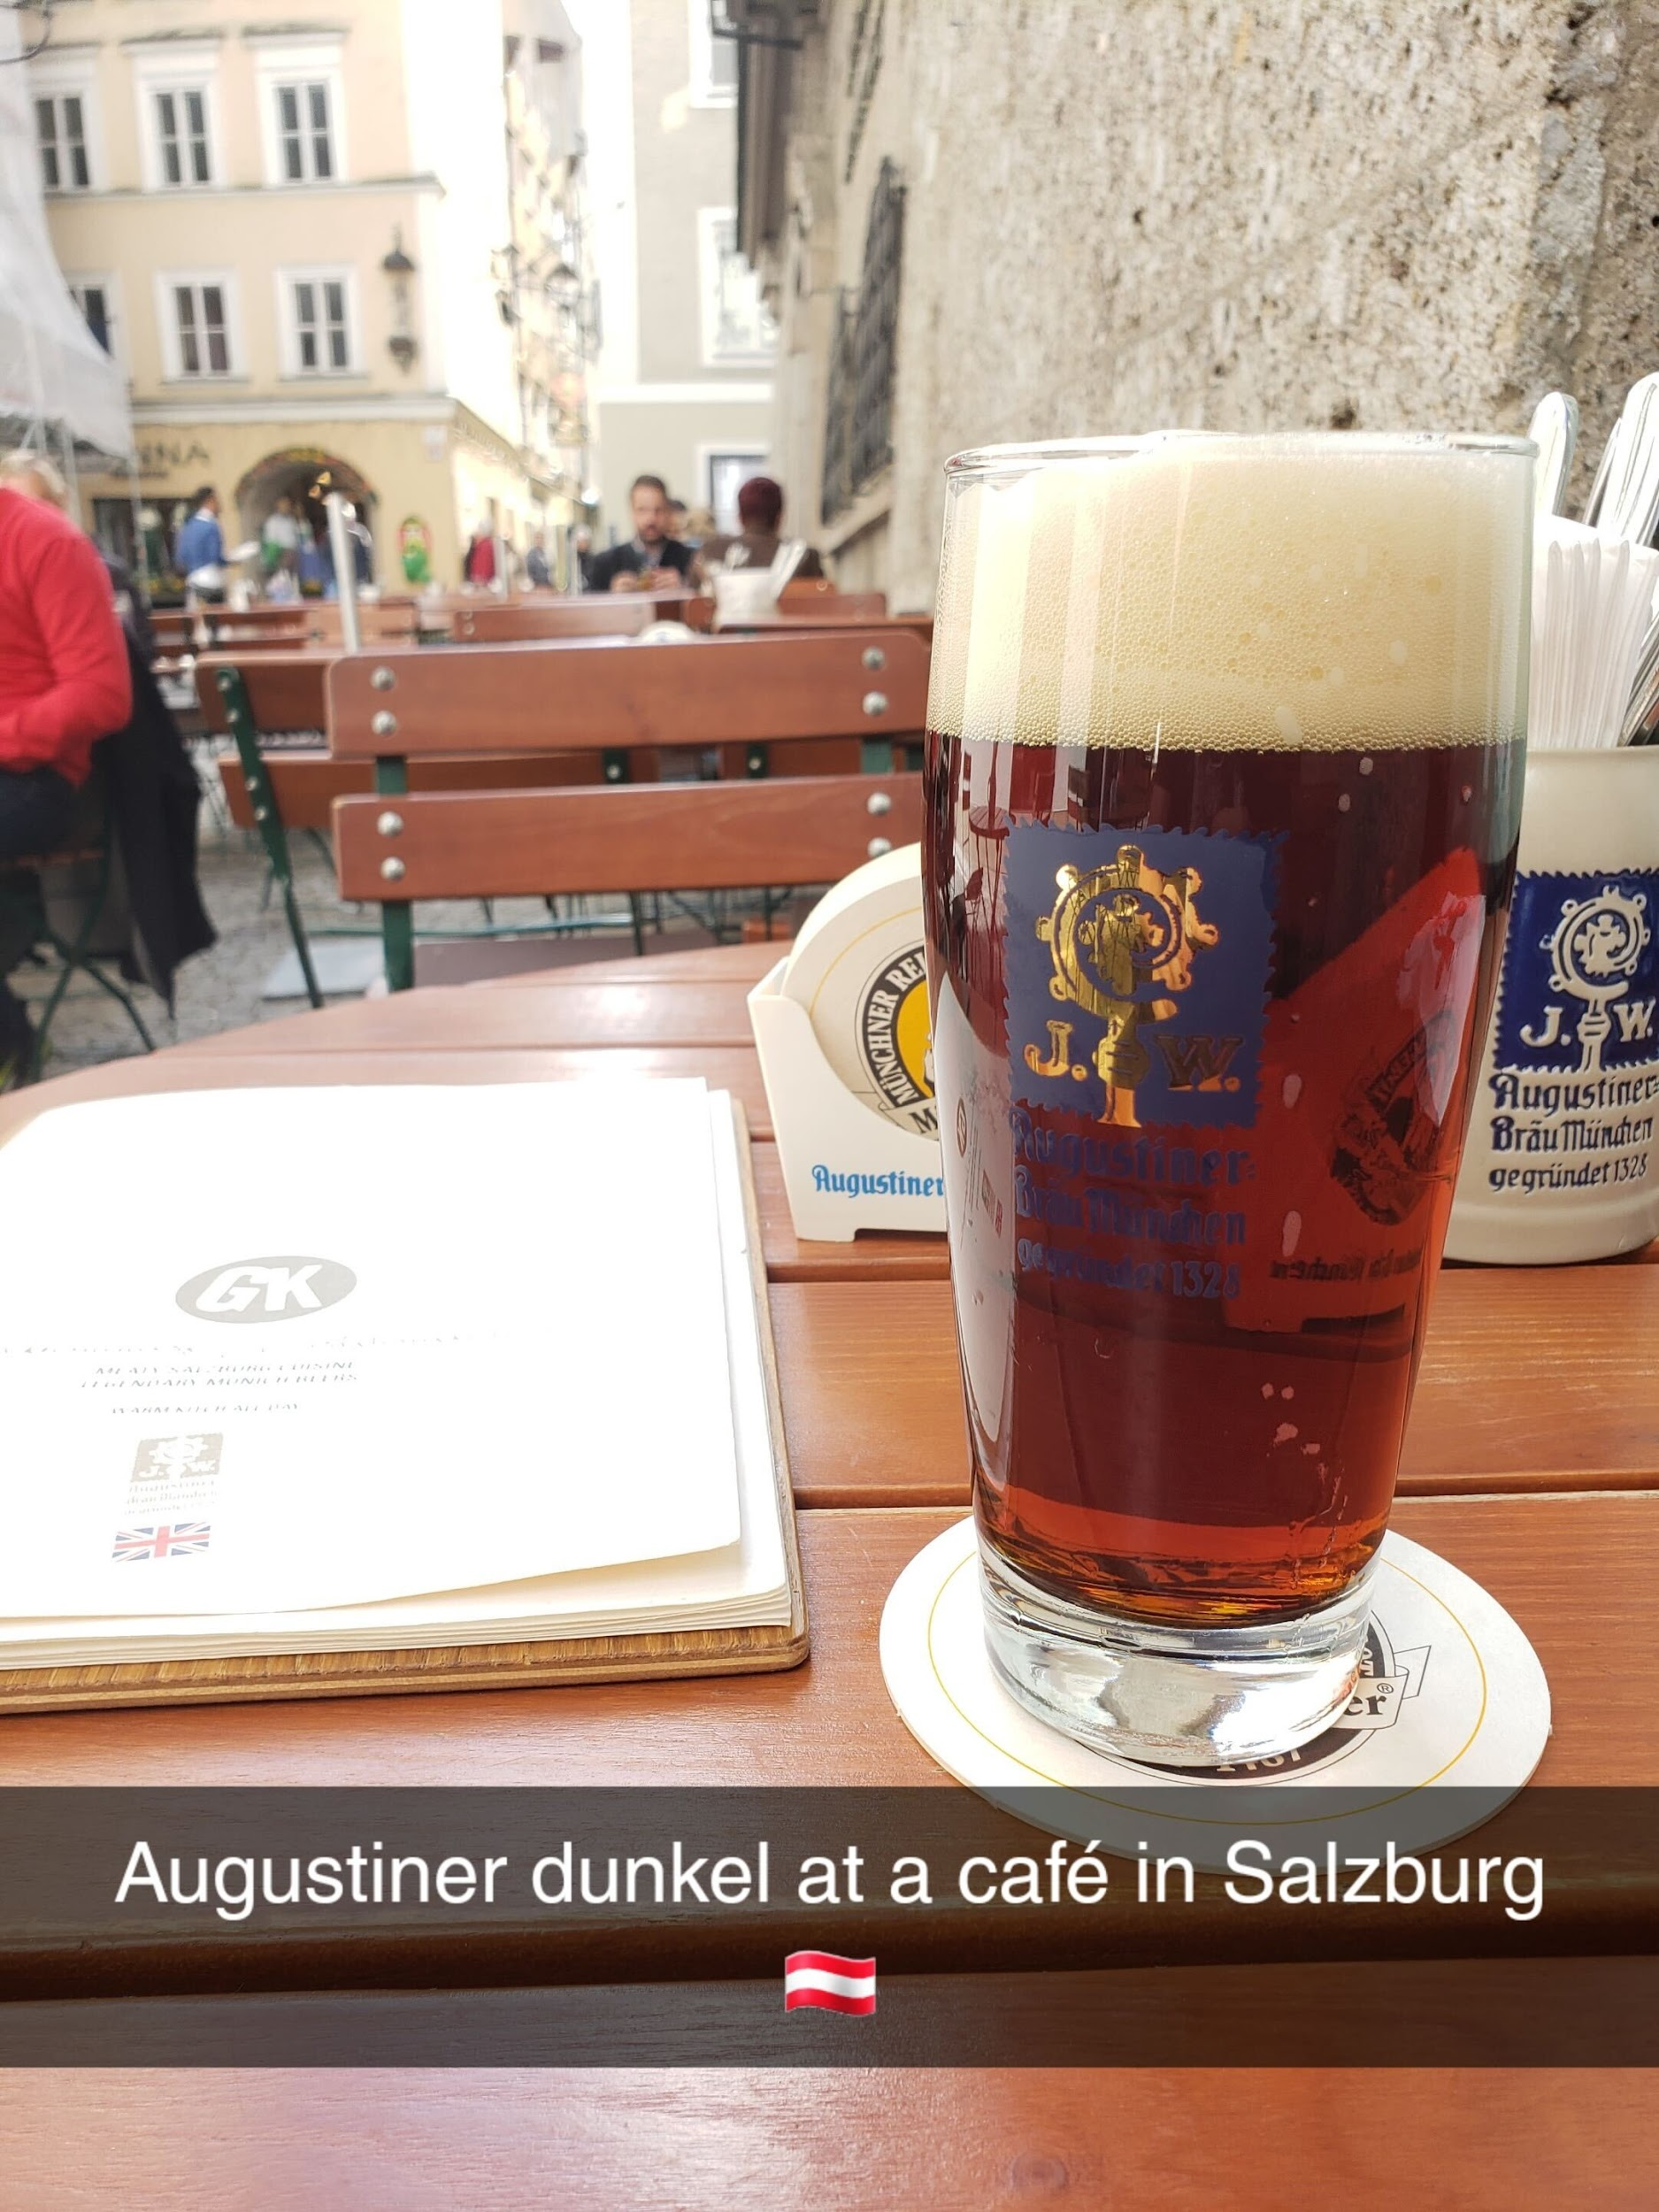
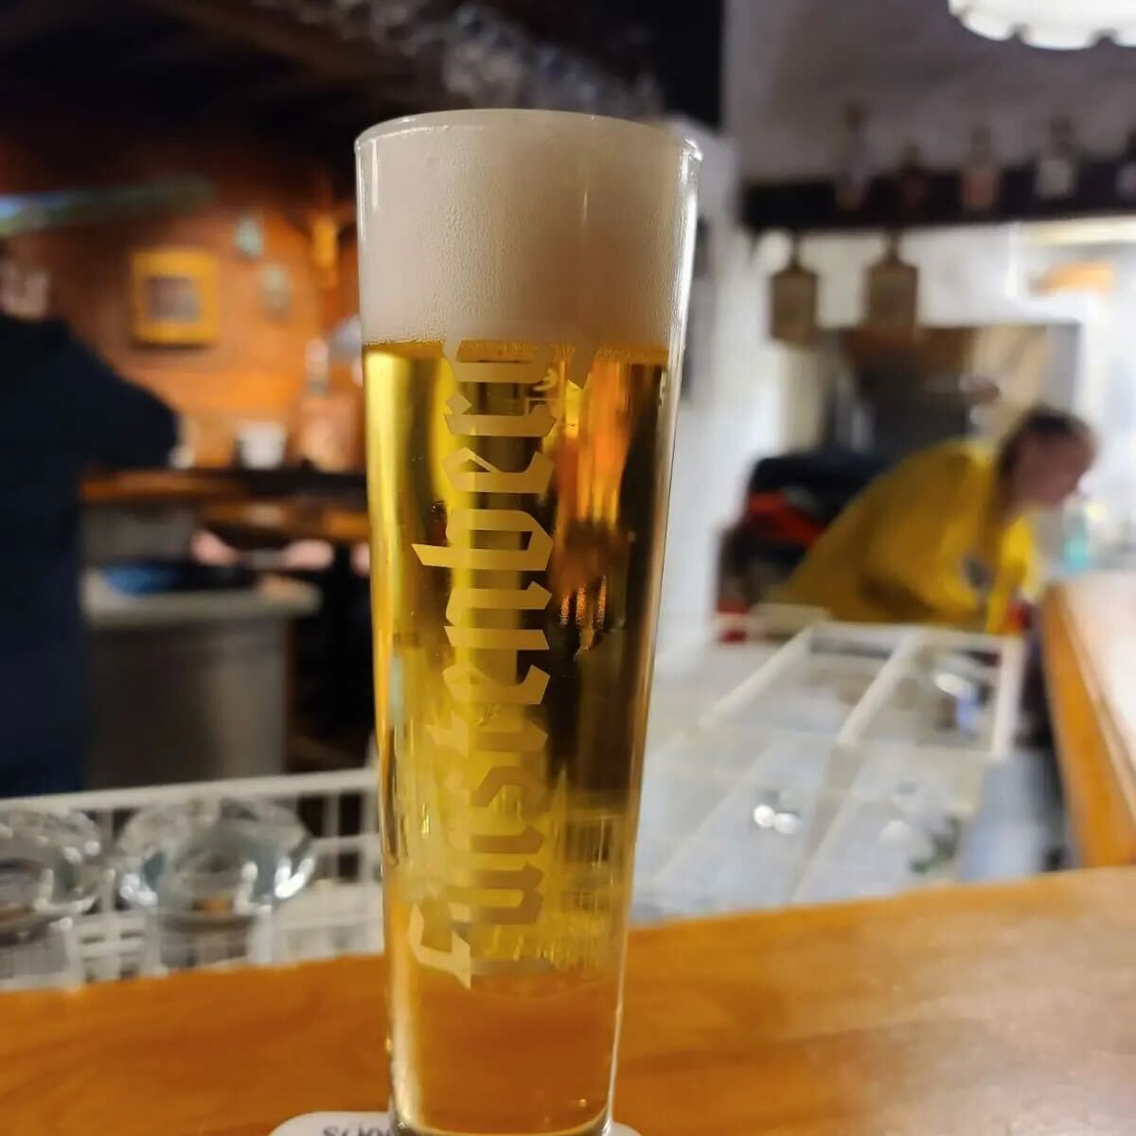
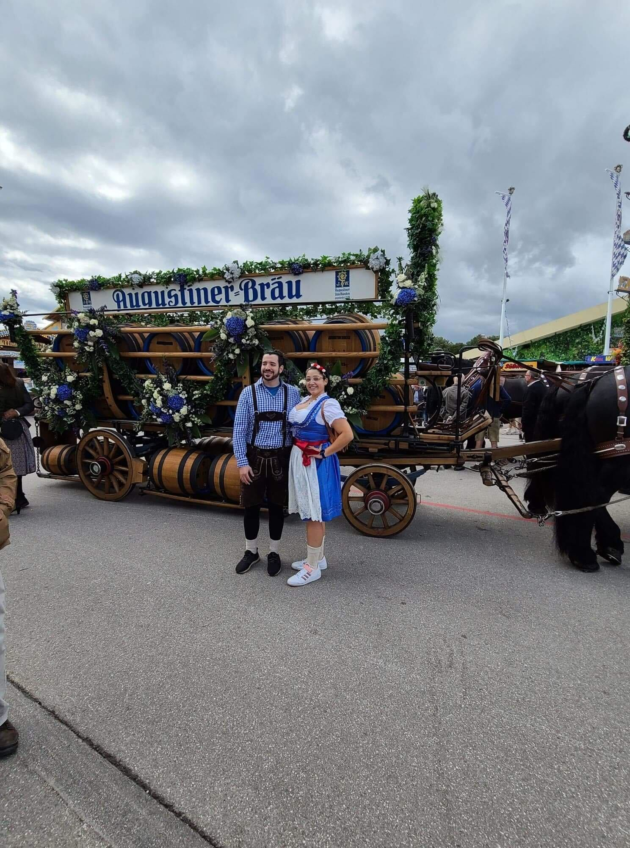
World Travelers

Slide 9
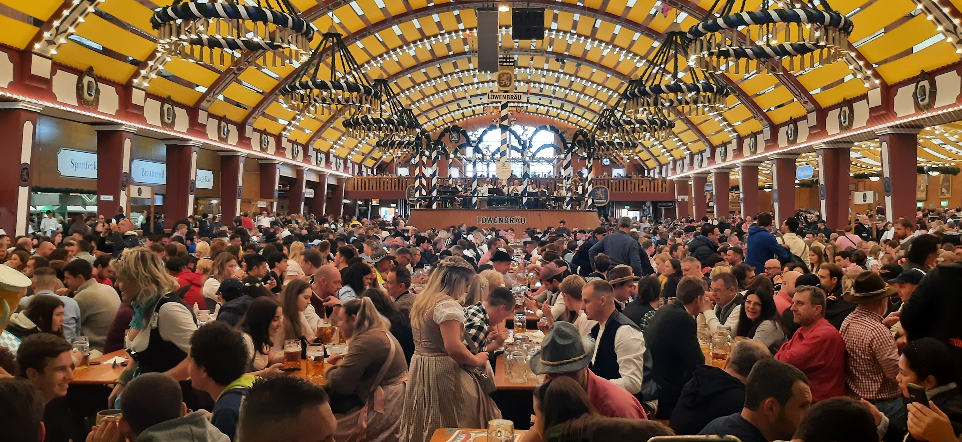
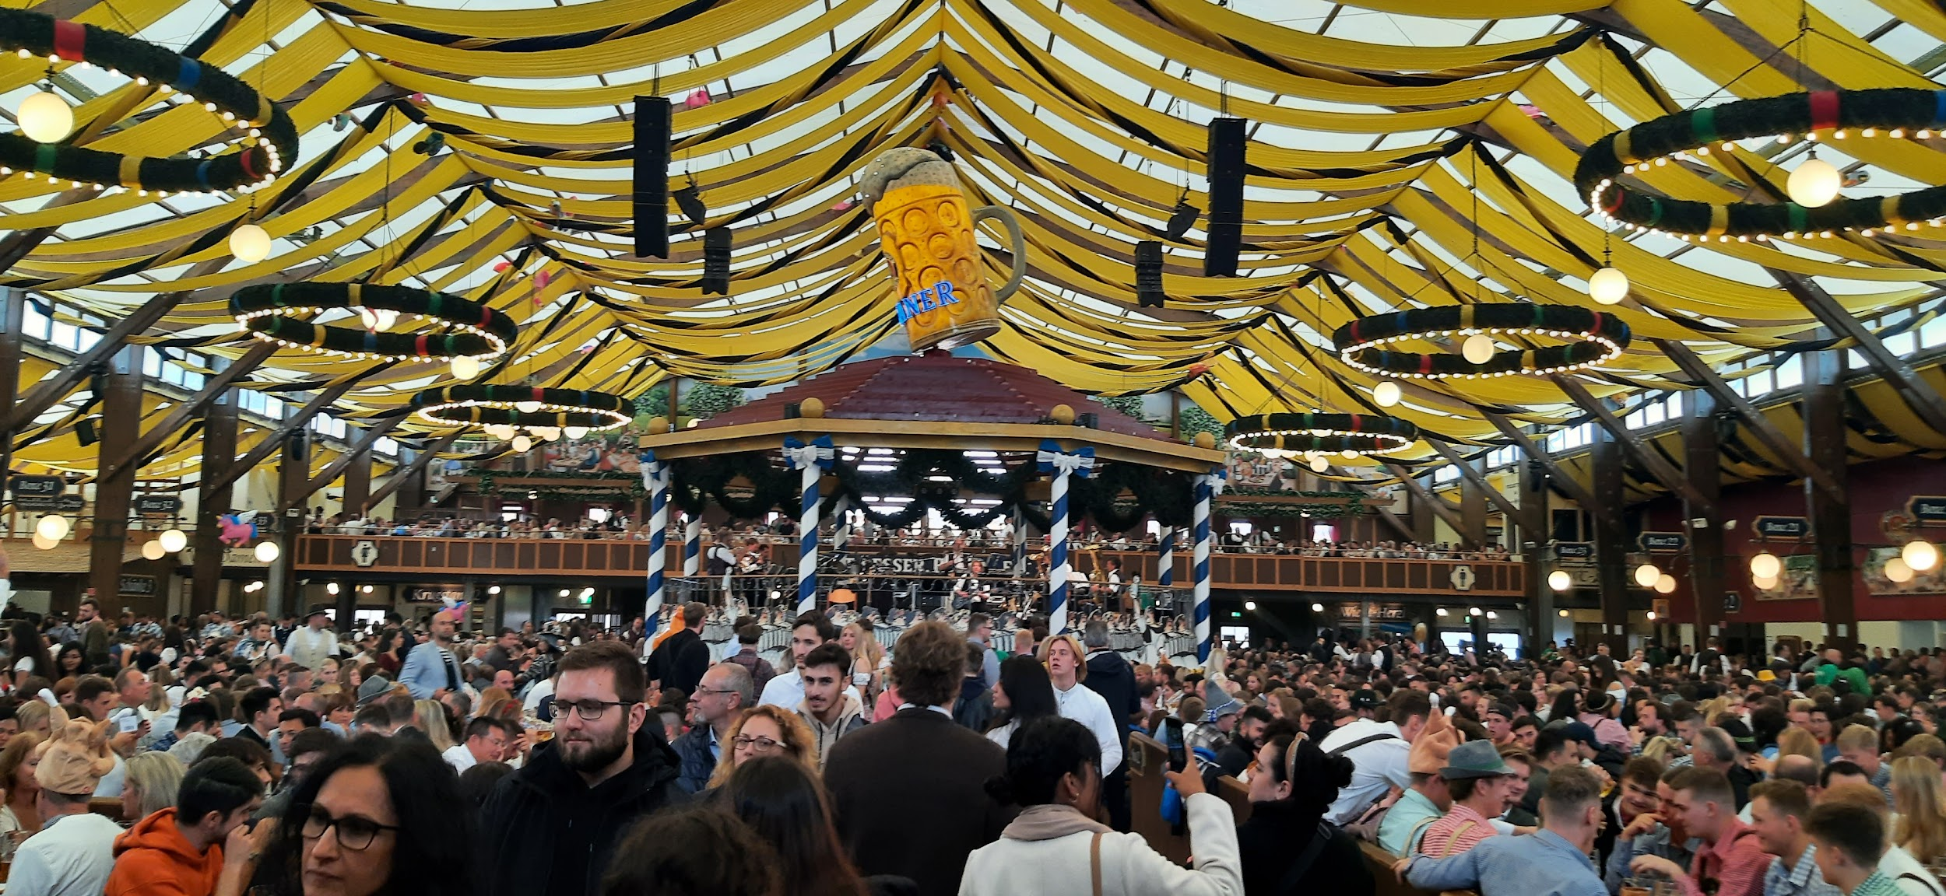
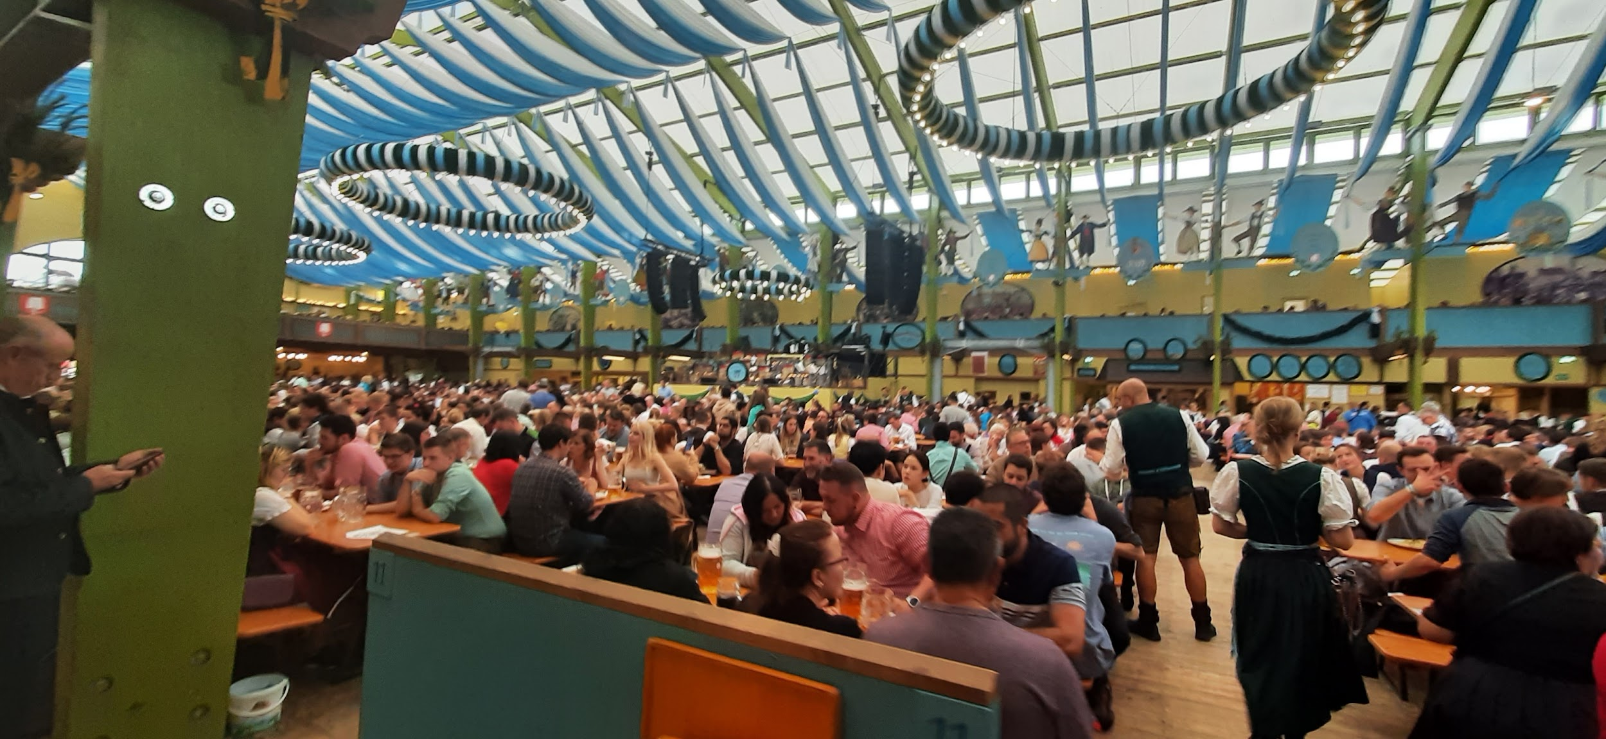
World Travelers

Slide 10
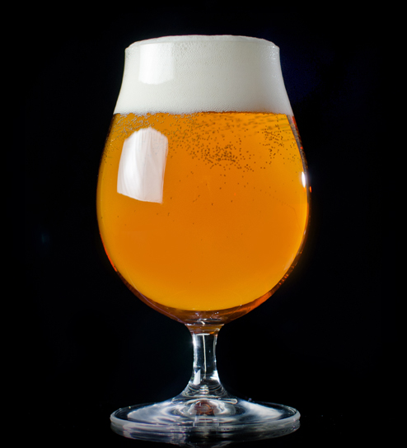
BOTY
NEXT MONTH
HISTORICAL BEER
Gose
Kentucky Common
Lichtenhainer
London Brown Ale
Piwo Grodziskie
Pre-Prohibition Lager
Pre-Prohibition Porter
Roggenbier
SahtI
PALE AMERICAN/IPA
18A-BLONDE ALE
18B- AMERICAN PALE ALE
21A- AMERICAN
21B- SPECIALTY

