Slide 1
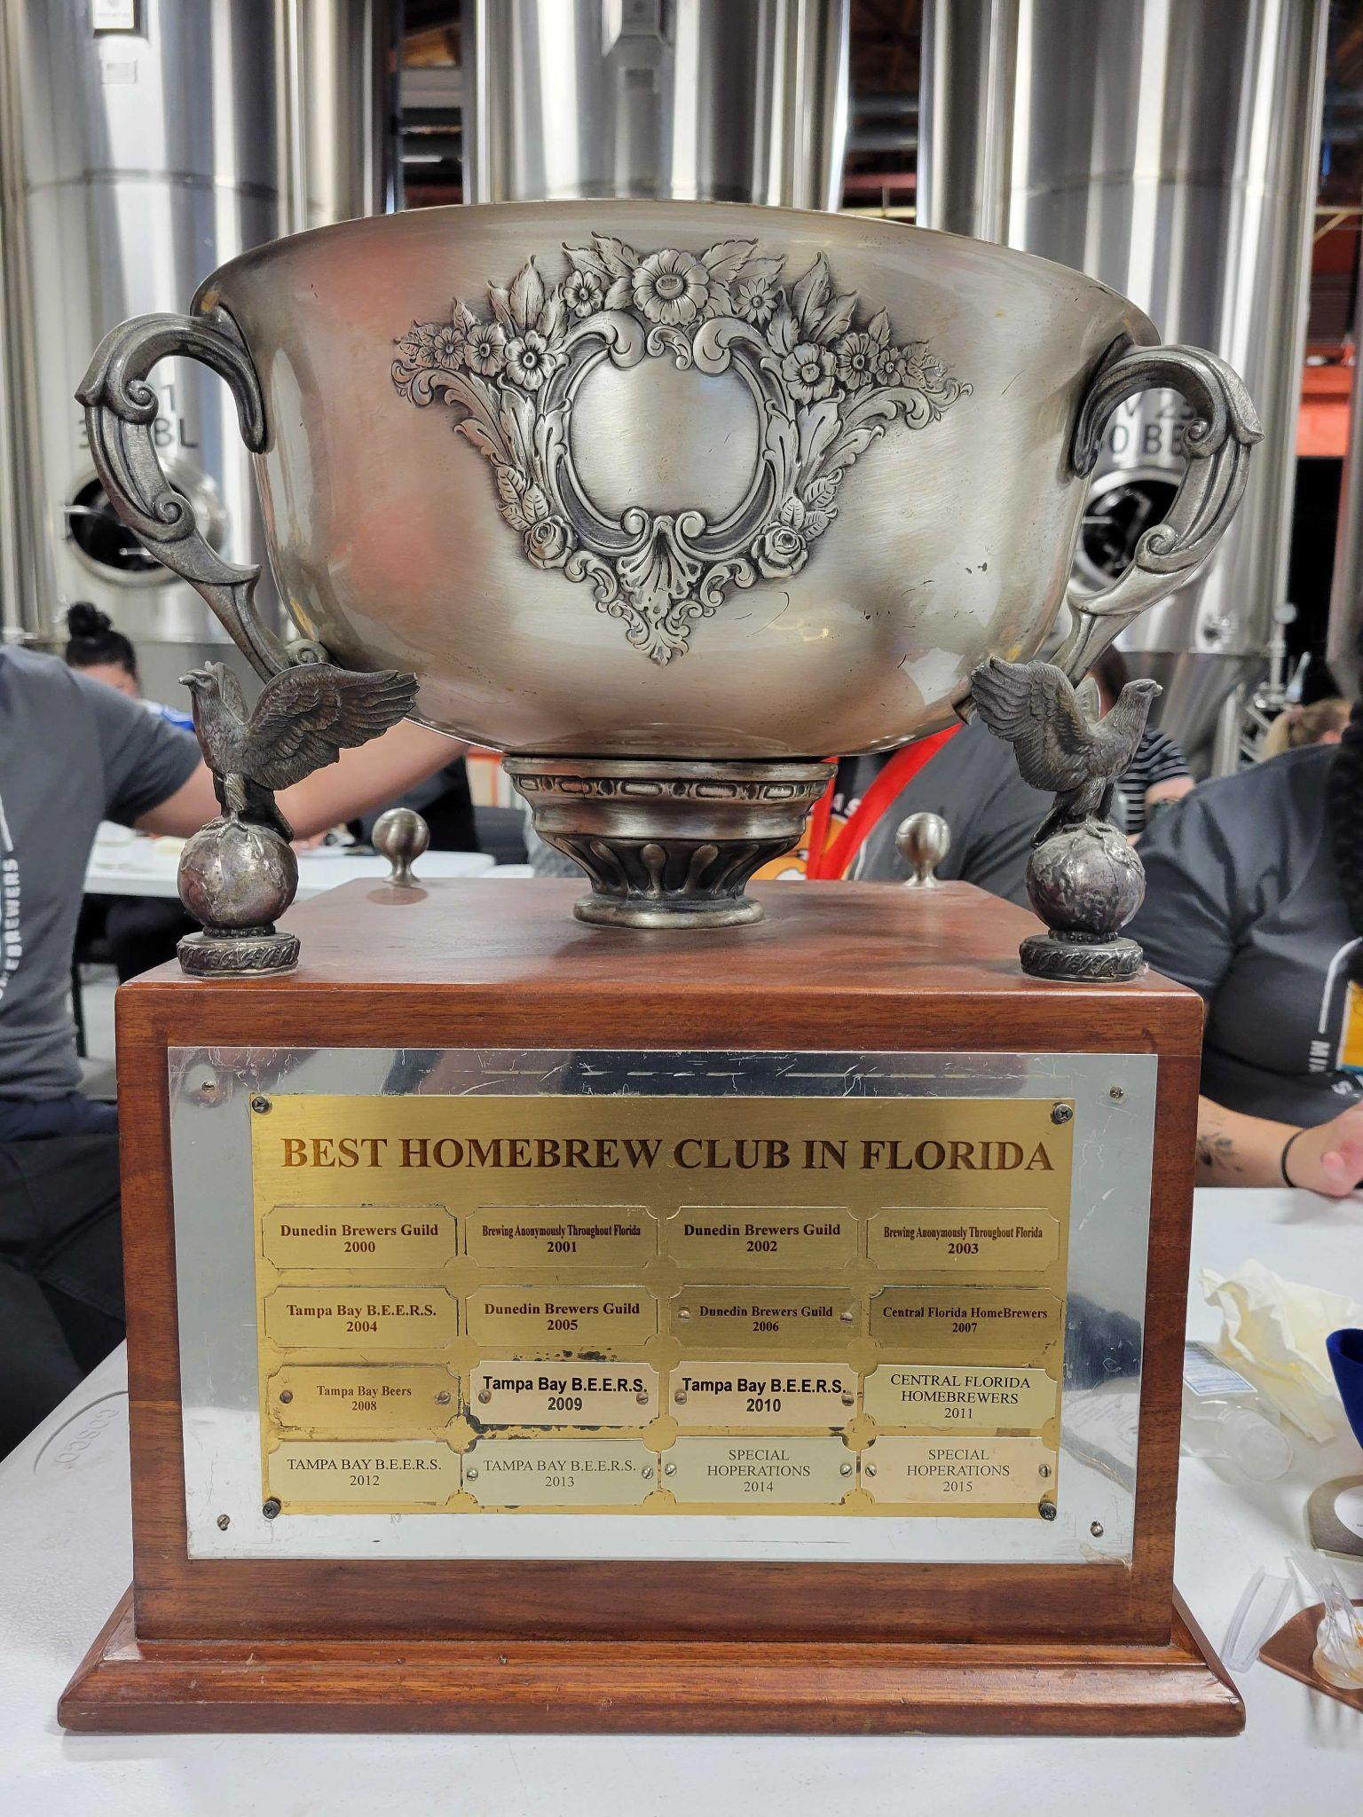
MASH MONTHLY MEETING MARCH 2023

Slide 2
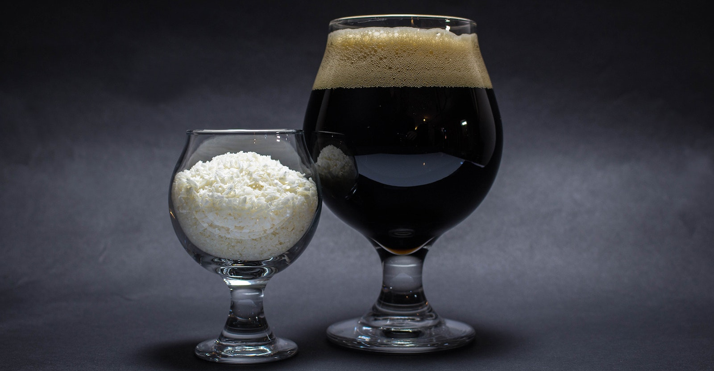
PRESIDENT’S GREETING

Slide 3
TREASURER REPORT
Current Funds: $4,901.98
Coco Cup entry fee revenue: $3,213.65
Coco Cup raffle: $125.40 (there’s more)
Member dues 2023 revenue: $381.79 (PLEASE PAY IF YOU HAVENT)!
Coco Cup expenses (final): $1,614.35

Slide 4
COMPETITIONS
Hurricane Blowoff
GIVE ENTRIES TO BOB!
Comp date: 4/29
Hogtown: FULL
Due date: 4/28
Comp date: 5/27
Hot & Humid
Registration opens 4/15
Due date: 5/26
Comp date: 6/24
First Coast
Registration opens 5/08
Due date: 6/29
Comp date: 7/29

Slide 5
Coconut Cup Medal winners
The club had 38 pts
Fernando 1 gold 3 silver 1 bronze Heavy Medal 2nd place
Chris 1 Silver
Brian 2 Bronze
Steve 1 Gold 1 Silver
Gary 2 Silver 2 Bronze
Macorix 1 Gold 2 Bronze
Roosevelt 1 Gold
Bob 1 Bronze
Rafael 1 Bronze

Slide 6
Brewer of the Year Standings
Brewer Name | Total Points
Gary Fuller | 25
Fernando Espino | 24
Macorix Perera | 13
Steve Hiller | 9
Roosevelt de los Santos | 9
Bob Billany | 9
Brian Gherarti | 6
Chris Nash | 5
Danny Smyth | 5
Matt Waldron | 5
Gary Fuller | 6
Matt Waldron | 5
Fernando Espino | 4
Rafael Dubois | 3
(extremely unimportant at this point)!

Slide 7
NEW & OLD BUSINESS
We have 4 new BJCP judges- Danny, Rafael, Roosevelt and Jim
LauderAle Homebrew Comp on 4/29
Veritage Miami CANCELLED
Ocean Brews and Blues Fest - Deerfield beach on 5/20
SFL Hops event in Ft Lauderdale on 6/17 – supportive of individual homebrew brands!
Future events and MASH ideas outside of meetings & comps?!? (spotlights at venues like Hybrid House and Thank You Miami are open to events) Reach out to the board!

Slide 8
BOTY
Strong European Beer 9A 9B 9C
Next Month Alternative Fermentable 31 A 31 B

